Slide 1


MakerDAO and the Dai Stablecoin

Slide 2
Platform for stability

Slide 3
1 DAI = $1

Slide 4

Why do we need stablecoins?
February 3-6

Slide 5
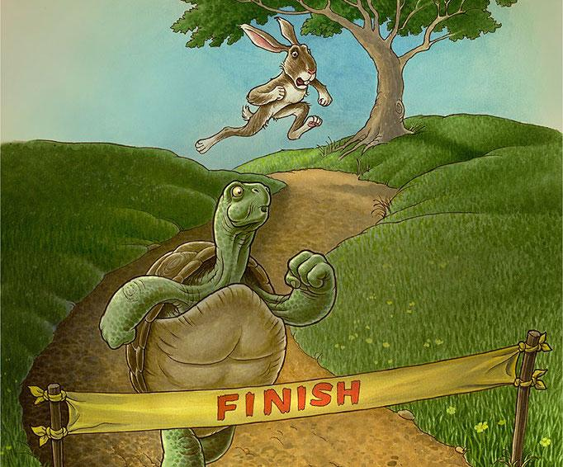
The Road to Dai
The Bitcoin winter of 2014 leads to Bitshares
MakerDAO: Bitshares on Ethereum
No ICO, no hype
Focus on security (DAO hack)
Focus on shipping products
OasisDEX
Sai Alpha
Dai is live

Slide 6
How it works
Imagine the gold standard but with any asset
Like an automatic balance sheet
Collateralized Debt Positions
For advanced users

Slide 7
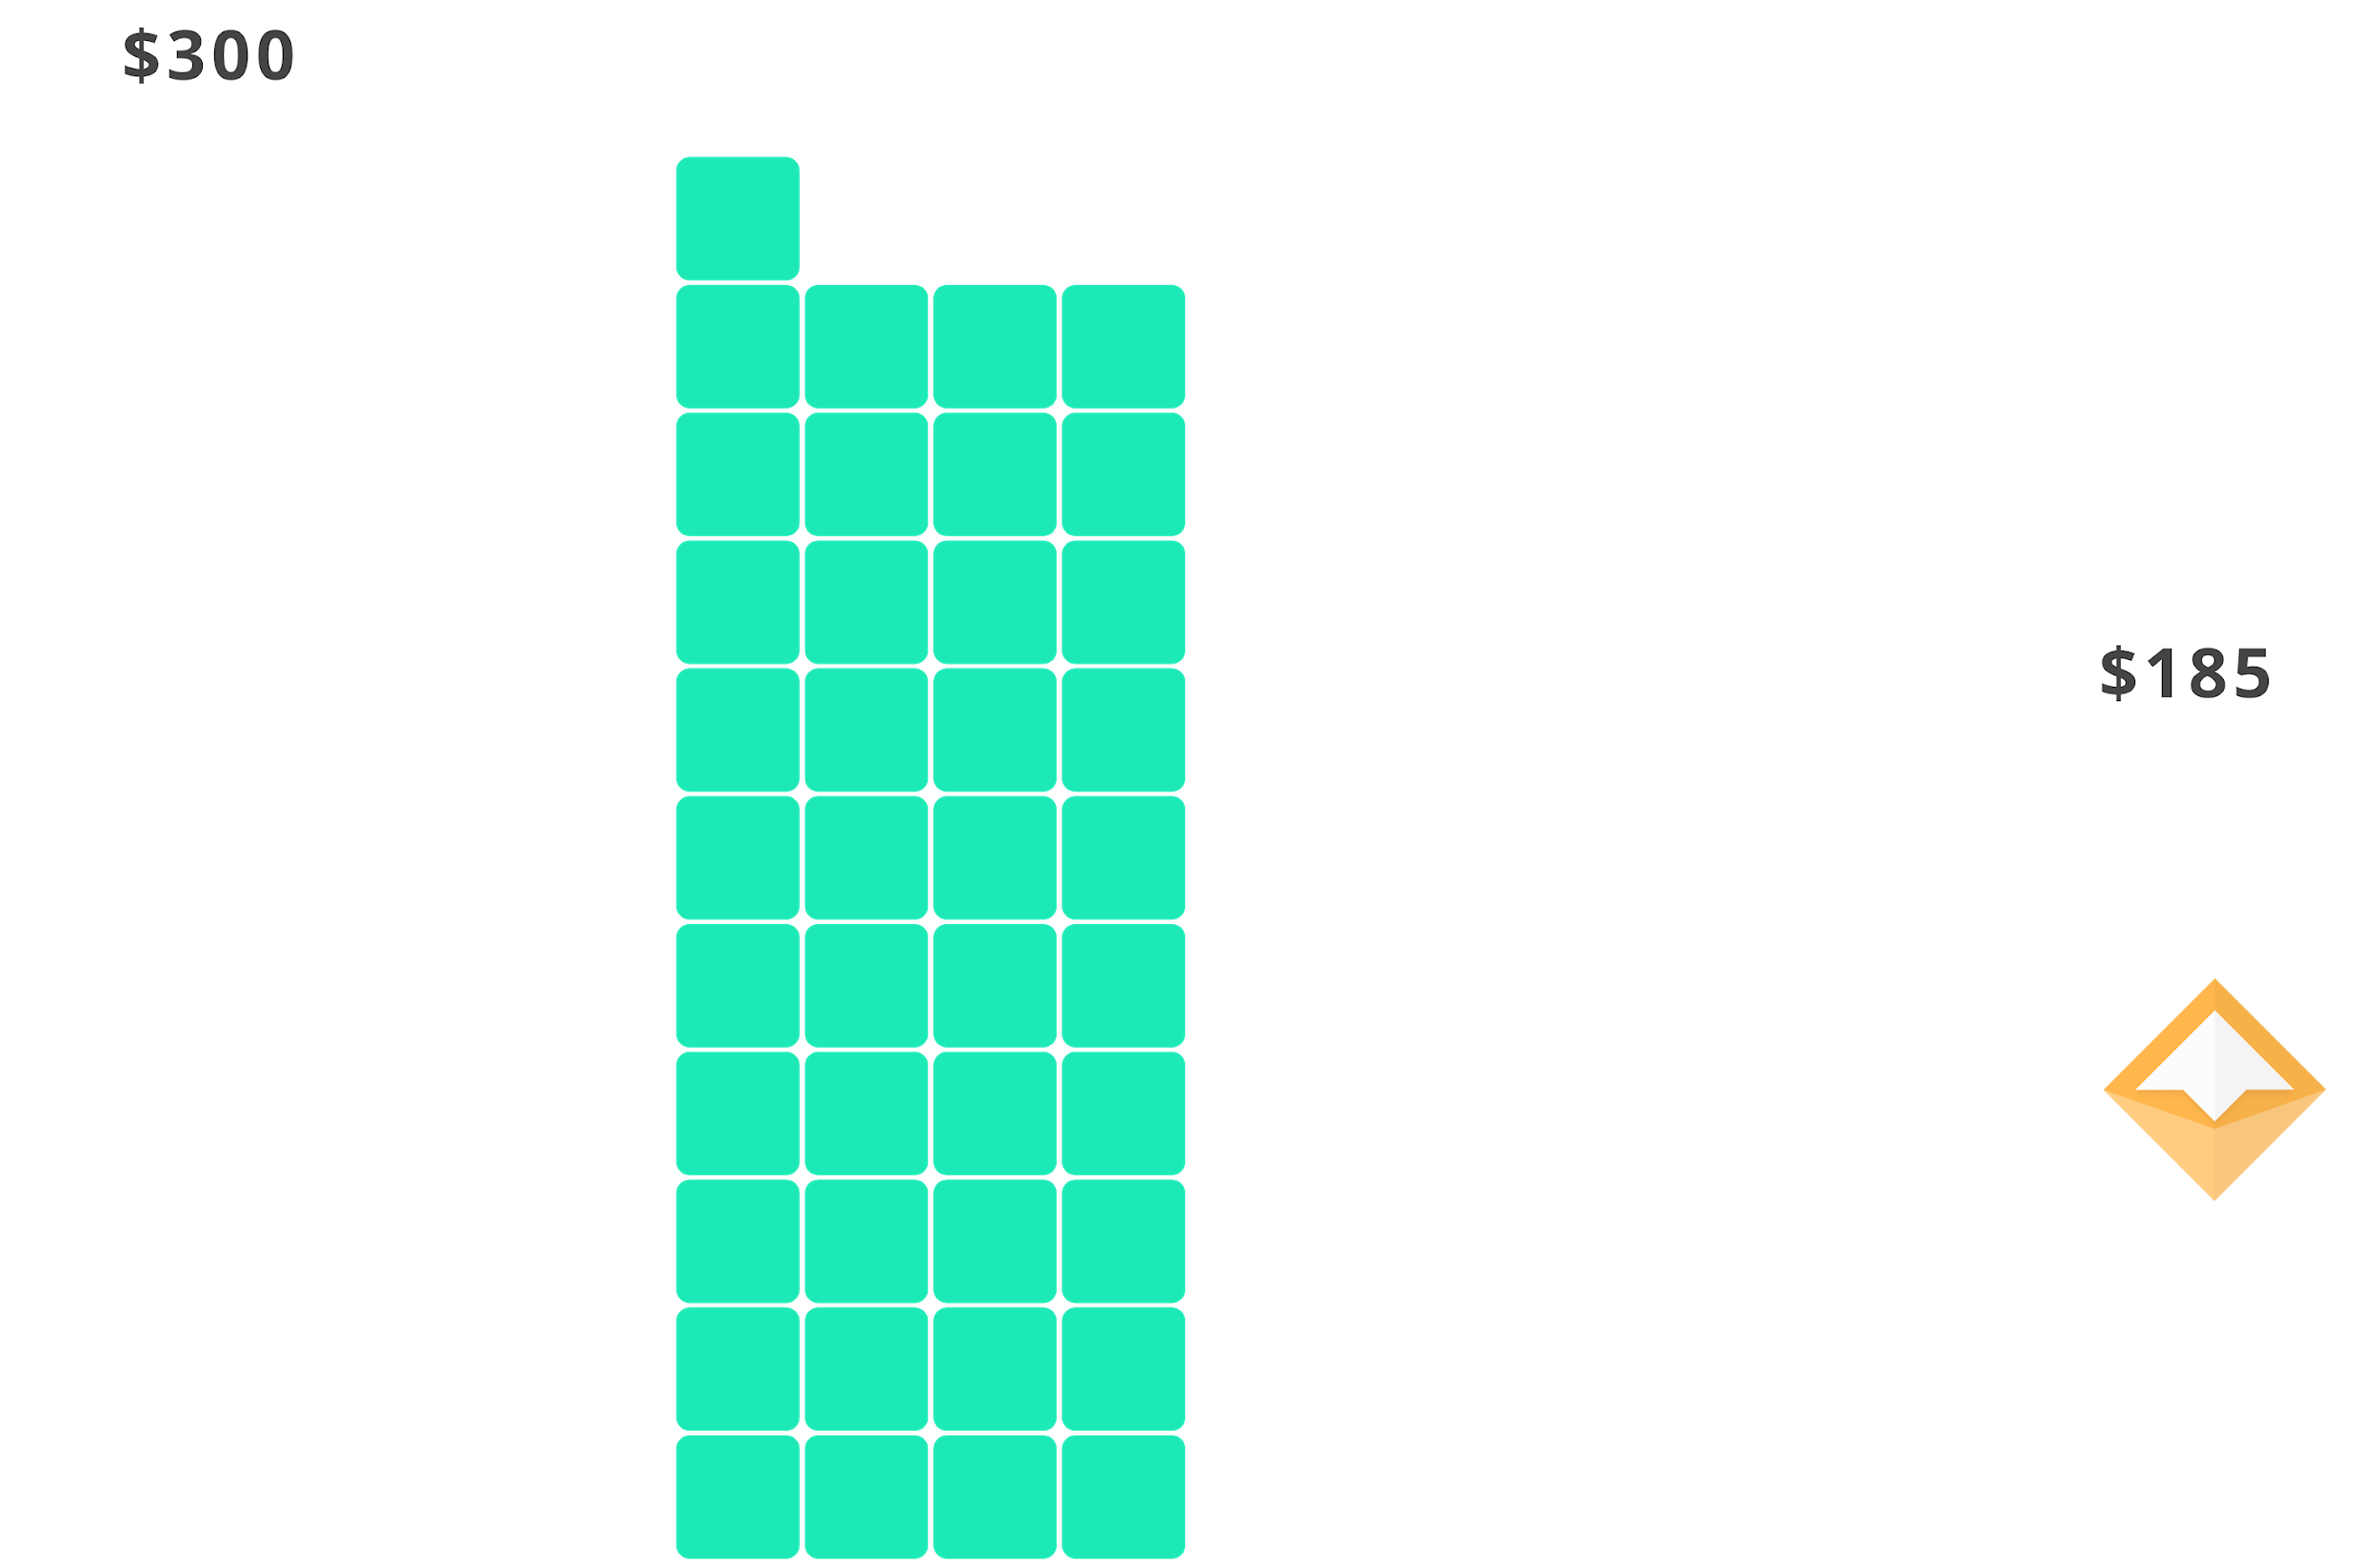
Credit system mechanics - Issue and Repay Dai
Borrow Dai with a Collaterized Debt Position (CDP)
Repay Dai + fee to retrieve collateral

Slide 8
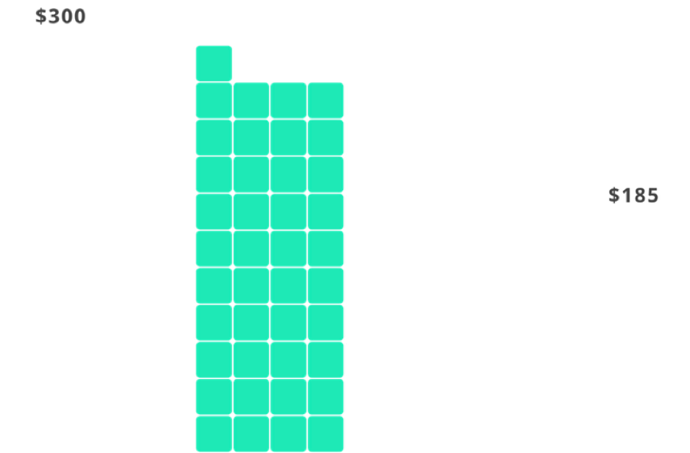

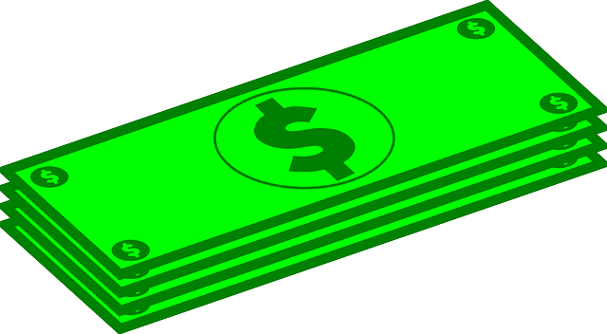
Credit system mechanics - Analogy
Borrow money with a mortgage from the bank
Repay debt + interest to “retrieve” the house

Slide 9
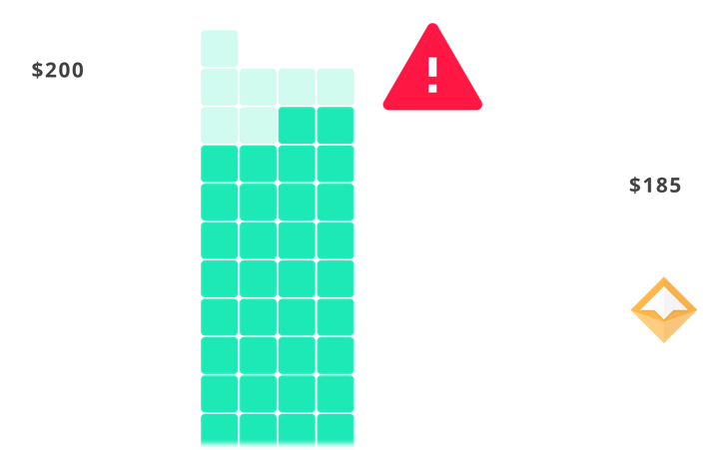
Credit system mechanics - Liquidation
CDP is automatically margin called if the collateral falls too low
CDP owner receive the leftover collateral

Slide 10
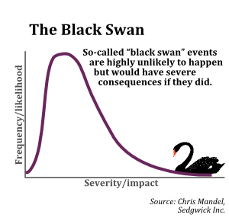
Black swan event
At current average collateralization:
Crashing 70% instantly
or
80-85% over 8 hours

Slide 11

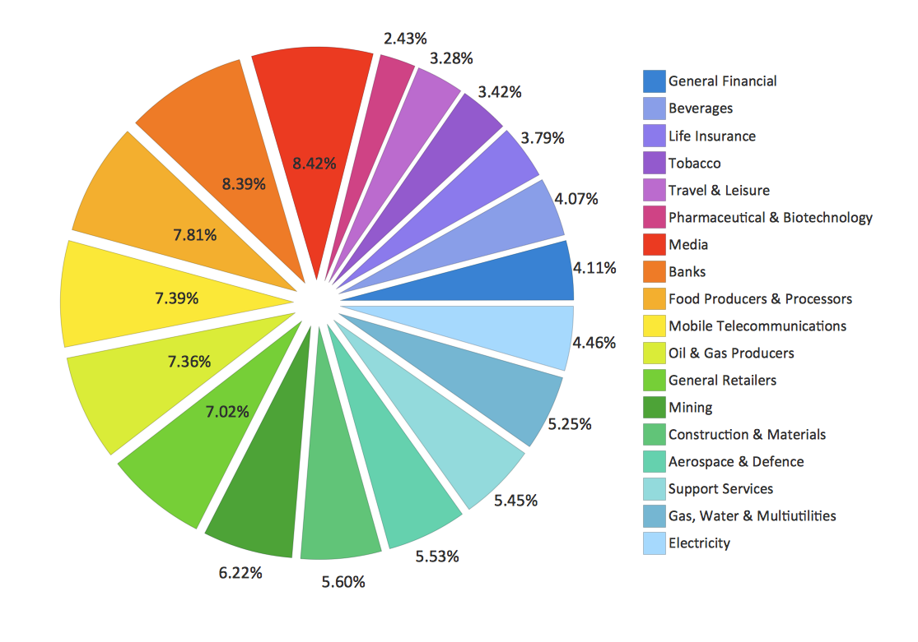
Diversification

Slide 12
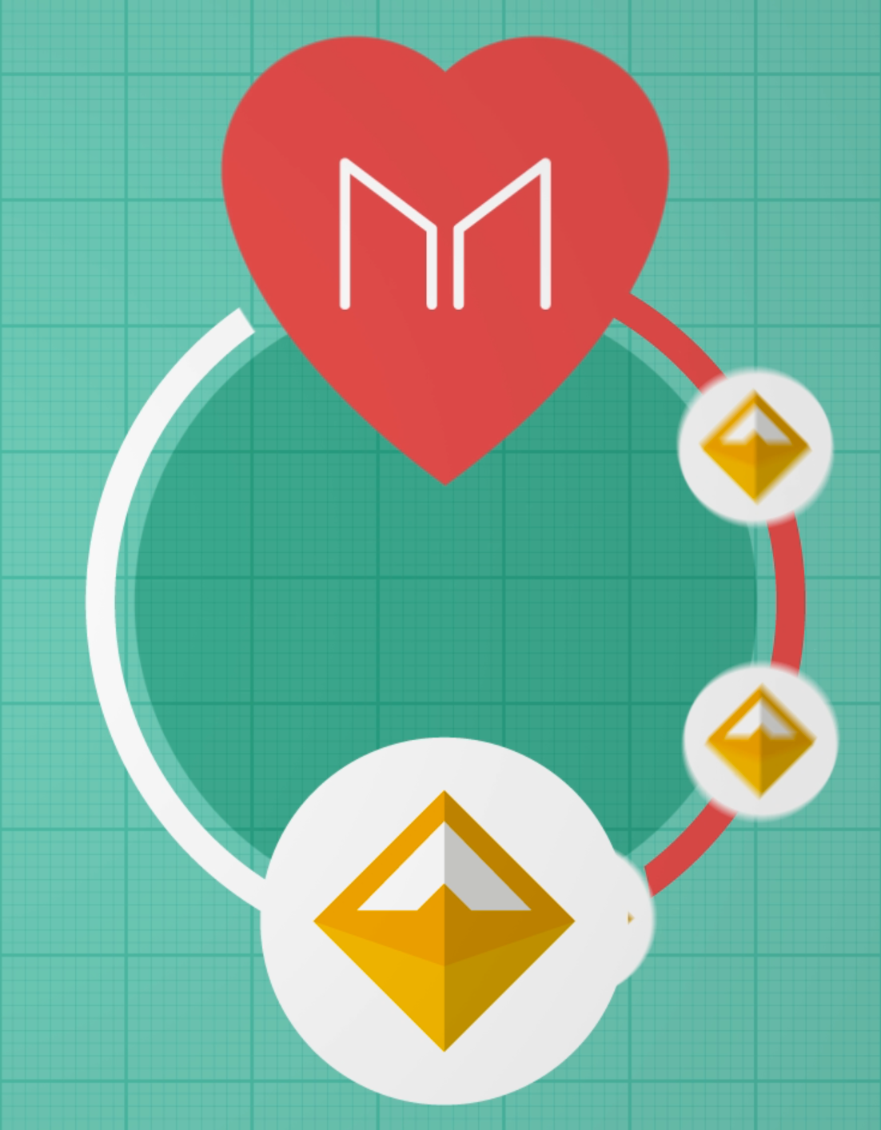
Maker
1,000,000 MKR held by more than 4000 people
“Highest risk, highest reward”
Manages risk
Finances bailouts
Earns income

Slide 13
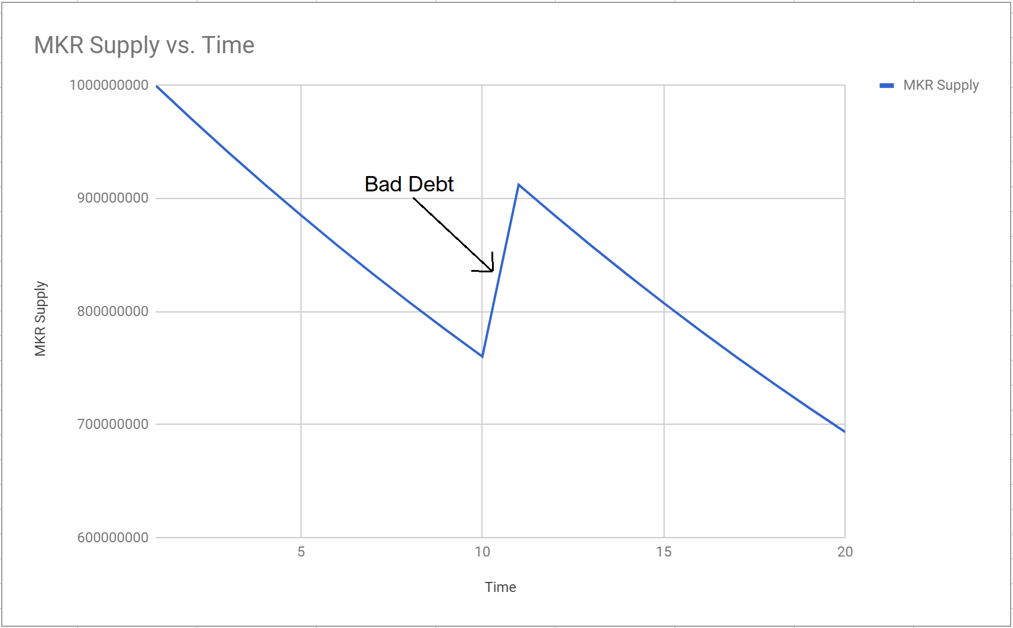

Slide 14


Simplified Diagram of the System
Second layer
guarantee
First layer
guarantee
Stability fee
Parameter Management
CDP

Slide 15
Industries
Remittance
Supply chain
Payments
Derivatives and insurance

Slide 16
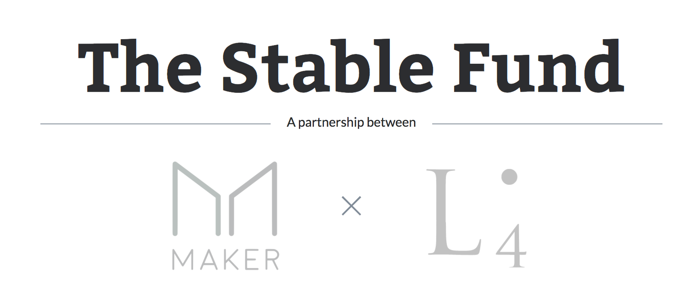
stable.fund

Slide 17
